Slide 1
Unveiling Heart Attack Risk through Data Insights
5/7/24
James Caldwell
Michael Burns
Notes:
Hi everyone we are Michael and James, and our project is unveiling heart attack risk through data insights

Slide 2
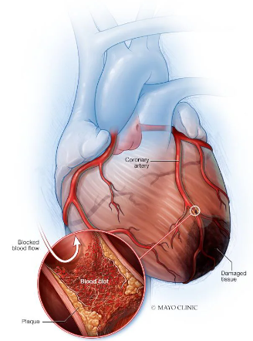
Data Summary and Problem Statement
Goal: train a model to predict whether a patient is at high or low risk of a heart attack.
Data Summary
Kaggle dataset: “Heart Attack Risk Analysis”
Medical and demographic info for >7000 patients
24 predictor variables including age, sex, BMI, heart rate, exercise habits, etc.
Data is a combination of numeric, binary, and categorical data
Our goal is to generate a probability of heart attack risk
Probability is thresholded into a 1 (high risk) or 0 (low risk)
Notes:
For this project, we hope to train a model that can predict whether a patient is at high or low risk of a heart attack.
We got a dataset from kaggle.
The dataset had 24 predictor variables including age, sex, BMI, heart rate, exercise habits, etc.
Data is a combination of numeric, binary, and categorical data
Our goal is to generate a probability of heart attack risk
So this was a binary prediction of 1 for high risk or 0 for low risk
Photo: https://www.mayoclinic.org/diseases-conditions/heart-attack/symptoms-causes/syc-20373106

Slide 3
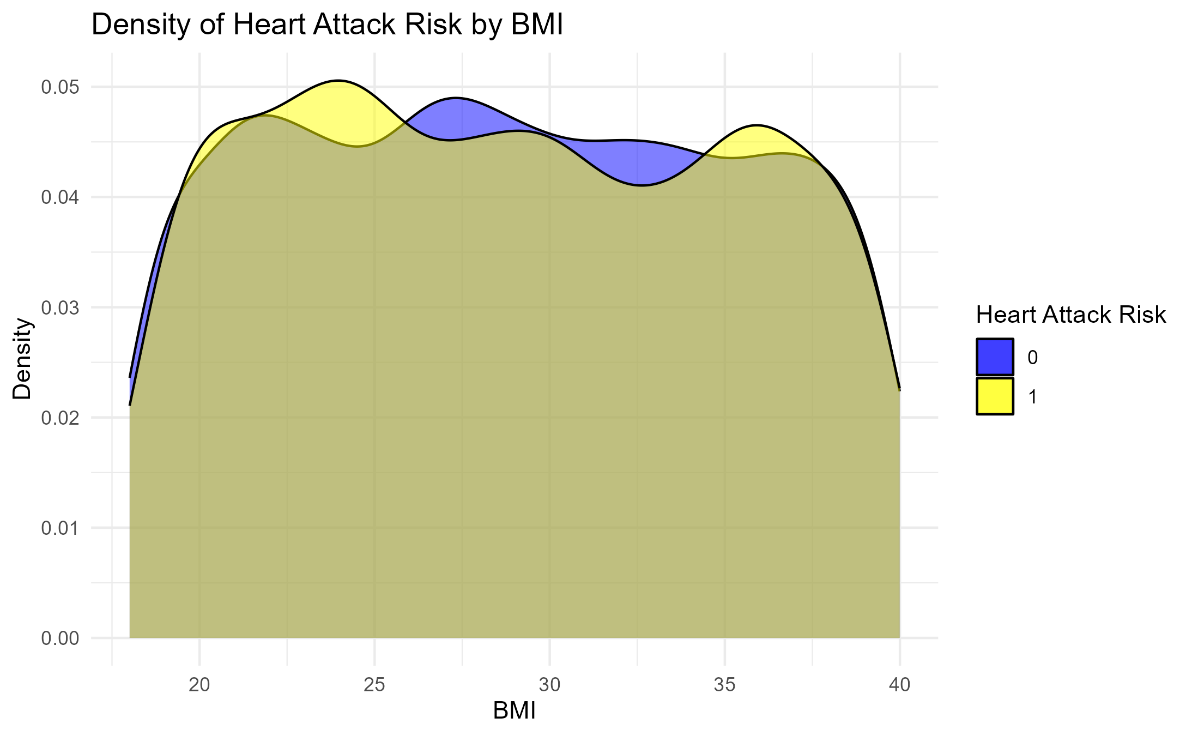
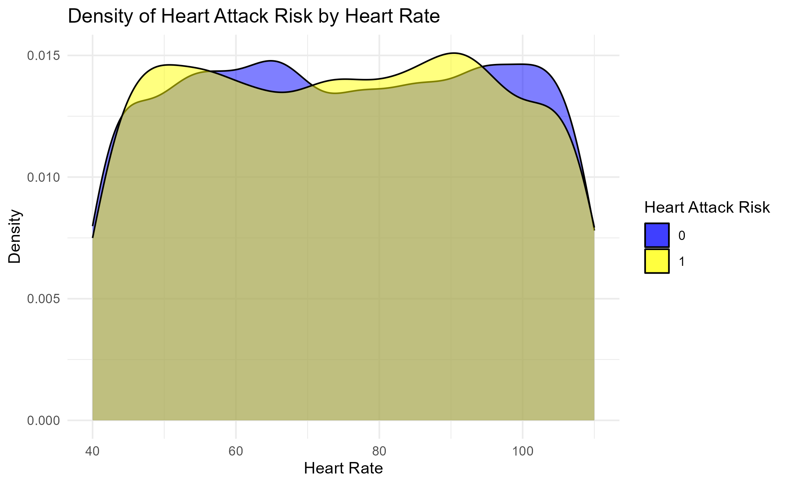
Data Exploration
Previous heart problems (binary data):
Risk if previous heart problems (1): 36.4 %
Risk if no previous heart problems (0): 35.1 %
Notes:
Before modeling, we did some brief data exploration. Here we show the density/percentages of patient correlation of BMI, heart rate, and previous heart problems to their heart attack risk level.
As you can see, the data is complex with multiple interaction points and small differences between risk level predictors.

Slide 4
Data Pipeline and Cleaning Steps
Download Data
Remove Patient ID
Handle Blood Pressure (Split)
One-hot Encode Categorical Variables
Determine Cost Function
90% Training
10% Holdout
Random Split Data
Scale Numeric Variables
Fit Random Forest
Fit Penalized Logistic Regression
Fit Boosted Trees
Evaluate Models on Holdout data
Done in Parallel
Evaluate Averaged Model on Holdout data
Fit an averaged model
Notes:
Michael
The first step was to download our data. Then we cleaned data by removing the patient ID, split the blood pressure values, one hot encoded the categorical variables, and scaled the numeric variables. We then made a random split of the data where 90% became training and 10% was holdout data,. This split was roughly even in the number percentage of positive heart attack risk outcomes. A cost function was determined by the application. In parallel random forest, penalized logistic regression, and boosted trees models were fit on the training data. Then each model was evaluated on the holdout data individually before an averaged model was fit and then evaluated with the holdout data.

Slide 5

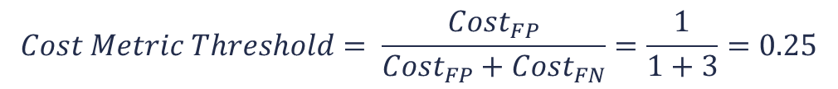

Cost Function
Our goal: Create a tool to see if you are at risk and should be evaluated/monitored by a doctor
NOT a diagnostic tool for assessing risk by a medical professional
False Positive: prediction of a heart attack when there is no heart attack
Low cost - only cost is getting evaluated when not needed
False Negative: prediction of no heart attack when there is a heart attack
High cost - never getting evaluated and potentially having a heart attack
Set:
$${Cost}_{FP}=1$$
$$Cost Metric Threshold= \frac{{Cost}_{FP}}{{Cost}_{FP}+{Cost}_{FN}}=\frac{1}{1+3}=0.25$$
$${Cost}_{FN}=3$$
Notes:
Michael
The goal of the project was to create a tool to see if you are at risk and should be evaluated by a doctor, not to create a diagnostic tool which changed our cost function choice. A false negative represented a prediction of heart attack when none was observed, which has a low cost because all that is done is an evaluation when it isn’t needed. A false negative represented predicting no heart attack when there is one, which has a high cost because it would mean not getting evaluated. We chose to set the cost of a false negative as 3 times the cost of a false positive, which gave a cost metric of 0.25.

Slide 6
Model Evaluation Metric
Model probabilities compared to the cost threshold to get a 1 or 0 prediction
Predictions classified against the true values as True Positives, True Negatives, False Positives, and False Negatives
All models were evaluated using accuracy
Higher accuracy = better model
$$Accuracy=\frac{TP+TN}{TP+TN+FP+FN}=\frac{Number of Correct Predicitons}{Total Number of Predictions}$$
Notes:
Michael
The models output probabilities which were compared to the cost threshold to get a binary 0 or 1 output for heart attack risk. Predictions were then classified as True Positives, True Negatives, False Positives, or False Negatives and evaluated based on accuracy using the formula seen here. A higher accuracy meant a better model when comparing.

Slide 7
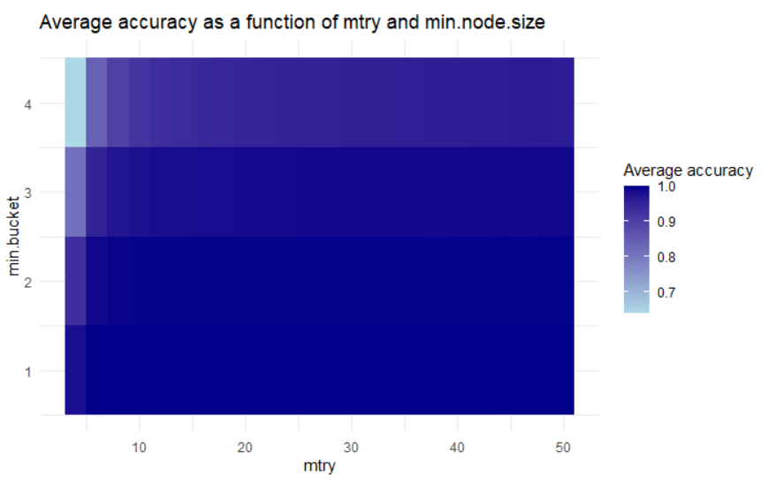
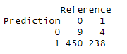
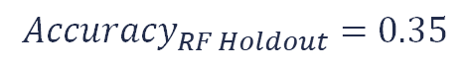

Random Forest
Tuned Parameters:
Number of Variables to Try – Optimal 46 (2-50 evaluated)
Minimum Bucket Size – Optimal 1 (1-4 evaluated)
Set Parameters
1000 Trees
Run each random forest 5 times for determination of tuning parameters
Final random forest model fit using the optimal tuning parameters on the training data
Predictions made to give the Heart Rate Risk for the training data
Random Forest model accuracy on the holdout data:
$${Accuracy}_{RF Model}=1.00$$
$${Accuracy}_{RF Holdout}=0.35$$
Notes:
Michael
A random forest model was fit with tuning parameters for the number of variables to try which was optimally 46 and the minimum bucket size which was optimally 1. There were also parameters set for 1000 trees and each random forest model was run 5 times to determine the tuning parameters. The final random forest model with optimal tuning parameters had an accuracy of 1 on the training data with the prediction distribution seen here. The model accuracy on the holdout data was 0.35, which is worse.

Slide 8
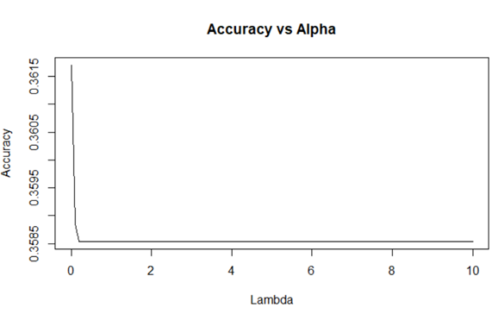
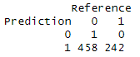
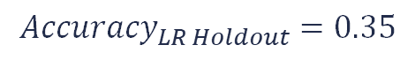
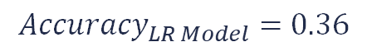
Penalized Logistic Regression
Parameter tuning done by glmnet cross validation
Alpha = 0
Lambda = 0
Fit a model using glmnet with family = binomial
Training Prediction summary
The model preferred high intercepts and a greater number of parameters
LR model accuracy on the holdout data:
$${Accuracy}_{LR Model}=0.36$$
$${Accuracy}_{LR Holdout}=0.35$$
Notes:
The next model that we chose to fit for our data was a penalized logistic regression model. We chose logistic regression since it is good for modeling a binary outcome.
We tuned our model for alpha and lambda using generalized linear model with cross validation. The model found alpha and lambda of 0 as optimal.
Once we tuned our parameters, we fit a model for predicting HAR probabilities.
As you can see, this model generated probabilities from .24 to .51, and had a train accuracy of .36.
For our specific dataset, our model tended to prefer mostly intercept based models with large number of coefficients with minimal penalty to parameter weight.
It had a holdout accuracy of .35.

Slide 9
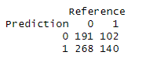
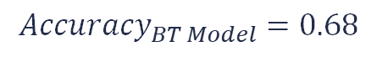
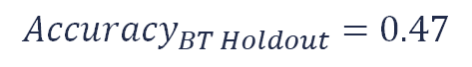
Boosted Trees
500 base models of gradient boosted simple decision trees
10 sequentially improving decision trees in each base model (nrounds = 10)
Predictions made from each base model
Meta-Model was trained using logistic regression and probabilities were predicted
Prediction Summary:
Meta-model accuracy
Boosted Trees model accuracy on holdout data
$${Accuracy}_{BT Model}=0.68$$
$${Accuracy}_{BT Holdout}=0.47$$
Notes:
Our next model was Boosted Trees using XGBoost.
We generated 500 base models. Each model was a simple decision tree that was then boosted 10 times, sequentially improving upon the mistakes of the previous models
Predictions for each patient was then made for all 500 models.
Then, we generated a meta-model of these 500 predictions for each patient and fit a logistic regression model for predicting probabilities of HAR for each patient.
This model made predictoins from 0 to 1 and had a accuracy on the training data of .68.
This model had the highest holdout accuracy of .47.

Slide 10
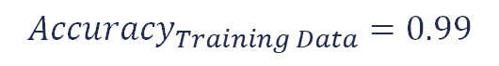
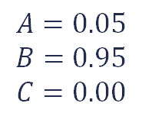
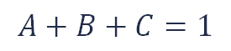
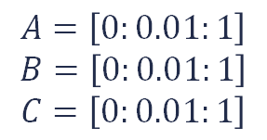
Model Averaging
The three models were averaged
5027 different combinations of coefficients were investigated:
The optimal coefficients were selected by an accuracy score of the final model
${Probability}_{Overall}=A∗{Probability}_{LR}+B∗{Probability}_{RF}+$ $C∗{Probability}_{BT}$
$$A=\left[0:0.01:1\right]$$
$$B=\left[0:0.01:1\right]$$
$$C=\left[0:0.01:1\right]$$
$$A+B+C=1$$
$$A=0.05$$
$$B=0.95$$
$$C=0.00$$
$${Probability}_{Overall}=0.05∗{Probability}_{LR}+0.95∗{Probability}_{RF}+0.00∗{Probability}_{BT}$$
$${Accuracy}_{Training Data}=0.99$$
Notes:
Michael
The three models were then averaged using coefficients A B and C. There were 5027 combinations of coefficients tested since A B and C were between 0 and 1 by .01 and they all had to sum to 1. The optimal coefficients were determined using accuracy of the averaged model to the training data with the logistic regression term being 0.05, the random forest term being 0.95, and the boosted trees term being 0. The averaged model accuracy on the training data was 0.99.

Slide 11
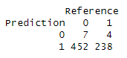
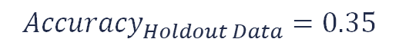
Model Evaluation with Holdout Data
Ensembled model was evaluated on the holdout data set
Confusion Matrix:
Many false positives – model is cautious to not report
Few false negatives – model is not missing many
$${Accuracy}_{Holdout Data}=0.35$$
Notes:
Michael
But when that same model was evaluated on the holdout data, we got an accuracy score of 0.35, which is not ideal. Looking at the confusion matrix though we see that most of the errors are in the false positive, which signifies our model is cautious which is not a bad thing. Our poor results are false negatives and here there were very few.

Slide 12
Conclusion
The best individual model evaluated with the holdout data was the boosted trees
The model stacking preferred was a random forest, with some input from logistic regression
Gradient boosted trees were determined to have no input
Model insights
The Random Forest model preferred deep, complex trees which ended up overfitting to the training data
This was computationally expensive
The Logistic Regression model preferred large intercepts and a greater number of parameters
The Boosted Tree model had the best holdout performance but was given less weight than RF for ensemble model
Lessons learned
Data engineering was crucial
Needed to keep track of probabilities vs predictions
Future work could look at the impact of the determined cost function
Notes:
The best individual model evaluated with the holdout data was the boosted tree
The model stacking preferred was a random forest, with some input from logistic regression
Gradient boosted trees were determined to have no input
From this process we gained insights into the strengths and weaknesses of the models:
The Random Forest model preferred deep, complex trees which ended up overfitting to the training data
The Logistic Regression model preferred large intercepts and a greater number of parameters. We believe our data was too complex for LR to do well making predictions since LR assumes a linear relationship between the predictor variables and the log-odds of the outcome
The Boosted Tree model had the best holdout performance but was given less weight than RF for ensemble model, likely because it wasn't as finely tuned to the training data
From this project, we learned several important lessons:
Data engineering was crucial for our dataset, and each improvement we made here saw improvements in model performance
We learned that we had the pay careful attention to whether our process/function was outputting predictions or probabilities. It was easy to accidentally compare predictions to probabilities or vice versa
Future work for this dataset could look at the impact of the determine cost function, as that certainly affected model stacking and model accuracies
And that's all we have for today, thank you very much.

Slide 13
Thank you

